Slide 1
New Student Orientation
Fall Semester 2024

Slide 2
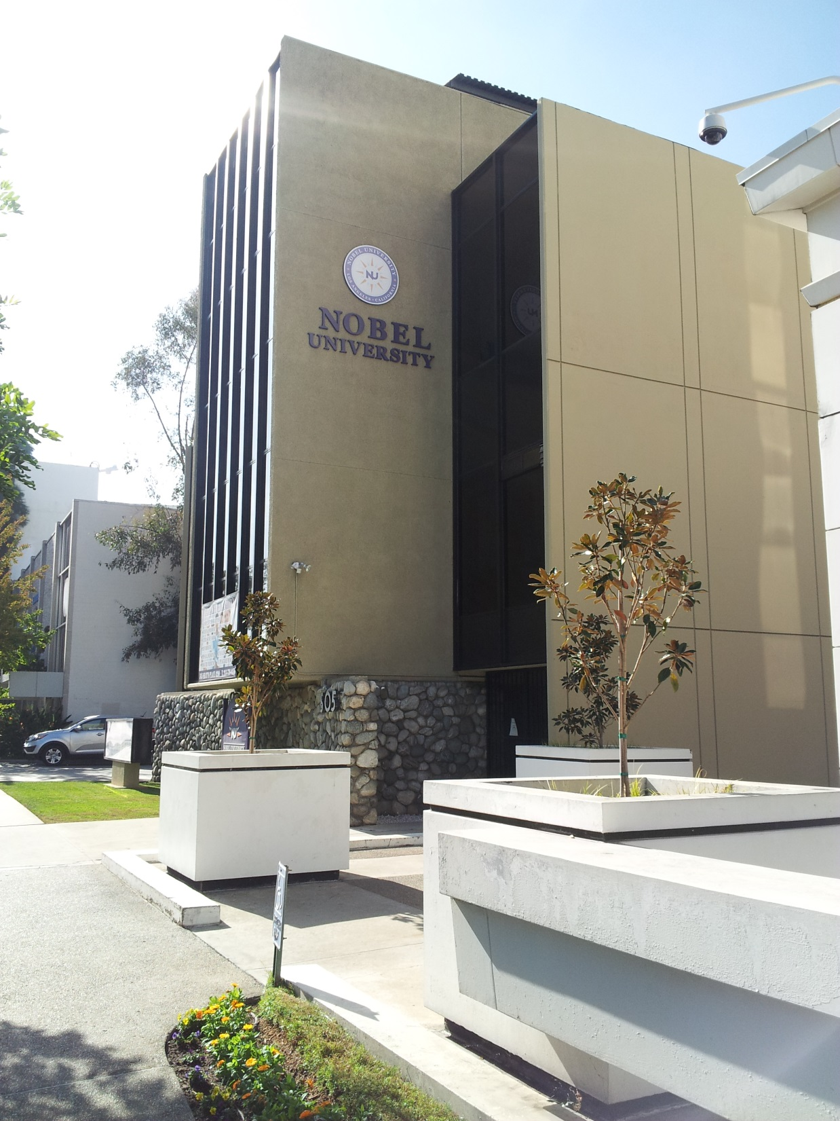
Welcome to your new future!

Slide 3
Meet our staff
President Chong S. Kim
Chief On-Site Administrator Ilsik Byun
Administrator of Admissions Junsuk Chang
Registrar Yoo Jin Jung
Finance Jeny Kim
Librarian Alida Montanez-Salas
Student Services John Hong

Slide 4
ACADEMIC PROGRAMS

Slide 5
Bachelor of arts in business administration
Programs is designed to broaden the spectrum of business courses with an understanding of cultural and sociological forces that shape business success.
Program length: 4 years
Minimum requirement per semester: 12 units
Graduation requirement: 120 units

Slide 6
Master of business administration
Program is designed to develop skills within the general function areas of business by utilizing a reality-centered academic experience through collaboration with the business community.
Program length: 2 years
Minimum requirement per semester: 9 units
Graduation requirement: 36 units (CPT is required to graduate from the program.)

Slide 7
Important dates
Semester begins: August 26, 2024
Last day to ADD/ DROP: September 6, 2024
Last day of class: December 13, 2024
Next semester begins: January 6, 2025

Slide 8
Holidays
University will be closed during these holidays:
Labor Day: September 2, 2024
Columbus Day: October 14, 2024
Veteran’s Day:
November 11, 2024
Thanksgiving Day:
November 28, 2024 – November 29, 2024
Christmas Day:
Dates TBD

Slide 9
Library
Library hours (Restrictions might apply due to COVID-19)
9 AM – 5 PM Monday – Friday
Books / Textbooks / Magazines / Newspaper
Online Library Catalog
Nobel Online Library®
Research Tools
Online Resources®
eBooks®

Slide 10
Student handbook review
Institutional Information
Statement of Non-discrimination/Equal Employment Opportunity
Freedom of Speech
Academic Freedom Policy
Sexual Harassment
Security and Safety

Slide 11
Student handbook review
Student Rights & Responsibilities
Freedom of Access: all services and facilities
Student Grievance Policy
Student Code of Conduct
Academic Dishonesty
Plagiarism
Copyright Policy
Drug, Alcohol and Smoking Policy
Weapons Policy

Slide 12
International students
During initial stay
Apply for CA. Driver’s License
Must be registered
Bank Account
Documents required: passport, visa, I-94, I-20
Cellular Phone
Prepaid phones available in major stores

Slide 13
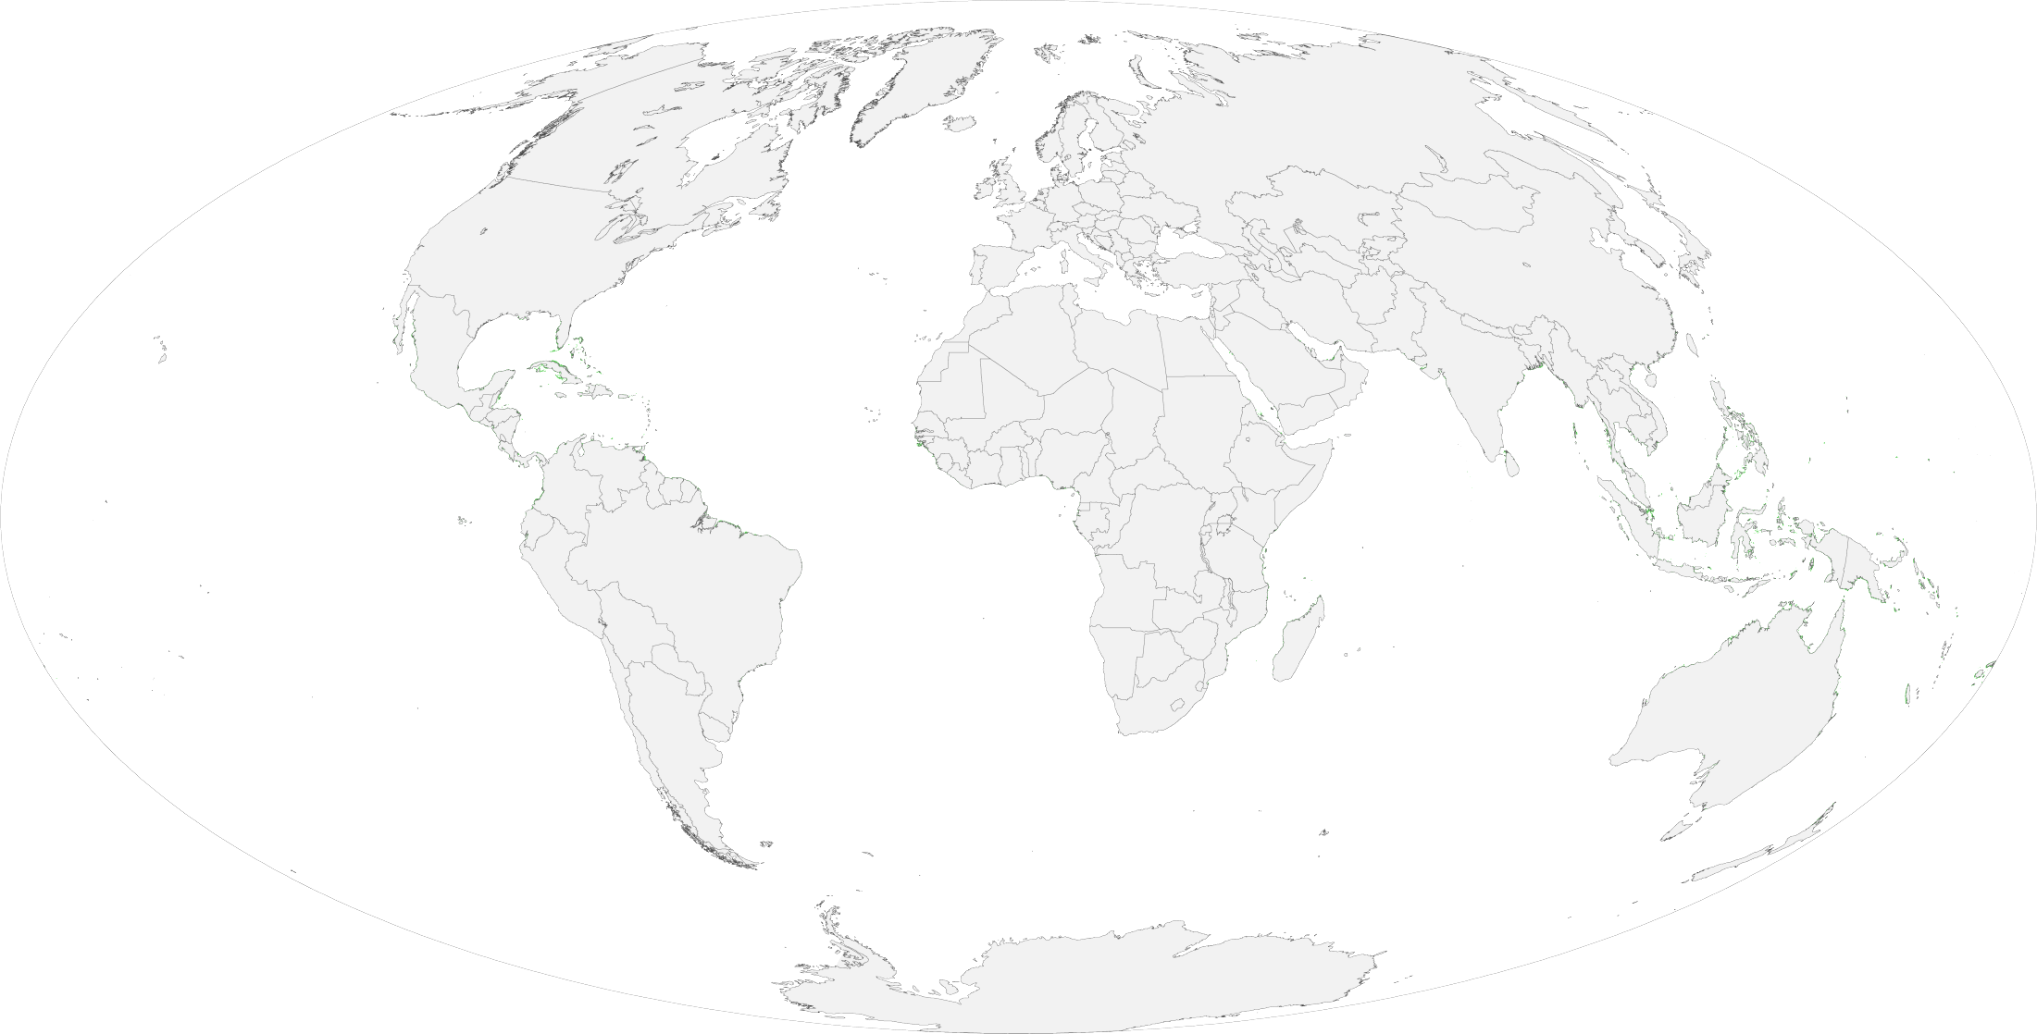
International students
Immigration documents
Passport: issued by your country’s Embassy
F-1 Visa: issued by the U.S. Embassy
I-94: entry/ departure record
I-20
DSO must sign annually on page 2 (required for travel)
Check if your information is correct
Request reissue after updates
Program completion date: last day of school

Slide 14
Annual vacation/ leave of absence
Annual Vacation
Each summer
May stay in the U.S.
May work on-campus
May study
Leave of Absence
Medical reason
Can stay in the U.S. (proper medical note required)
Personal reason
Must leave the U.S.
Re-enter as early as 30 days prior next session start date
Must notify DSO for I-20 to be changed back to “Active”

Slide 15
Transfer out
Complete an exit interview
Submit proper withdrawal documents
Clear all financial obligations
Submit the acceptance letter and transfer form from transfer-in school to the International Student Advisor (DSO)

Slide 16
Student services
Academic Advising
Activities: guest speakers, events
Career Services: workshops, job search, OPT
Graduation Ceremony

Slide 17
Welcome to Nobel University!

